Slide 1


Introduction To Computer
Binary Addition
Instructor:
Mohammad Hasan
B.Sc Engineering in CSE
Final Semester, Final Year.
Kryptonite Lab
Coding Flow

Slide 2
Binary Addition-
3 steps that we follow
Add the first rightmost column
If the sum exceeds one, carry ’1’ goes to the next column
If there are additional columns then goes to step 2, otherwise stop

Slide 3

Binary Addition-
0 + 0 = 0
0 + 1 = 1
1
Carry
1 + 0 = 1
1
0
1 + 1 = 0, with a carry of 1
+1
1
1
1 + 1 + 1 = 11, with a carry of 1

Slide 4
Binary Addition-
0 + 1 = 1
Carry
Carry
Carry
1
1
1 1 1 1 0
1 1 0 0
+
1 0
1 0
1 0
1
0
1
0
1
0
Put in
Put in
Put in

Slide 5
Binary Addition-
Carry
1
1 0 . 1 0 0
0 . 1 0 1
+
1 0
1
1
.
0
0
1
Put in

Slide 6
Binary Subtraction-
2 steps that we follow
If lower digit is greater than the upper digit, borrow from the next column to the left
Subtract the lower value from the upper value

Slide 7
Binary Subtraction-
4 possibilities that we find
Subtraction
Result
Borrow
0 – 0 =
0
0
1 – 0 =
1
0
1 – 1 =
0
0
0 – 1 =
1
1

Slide 8
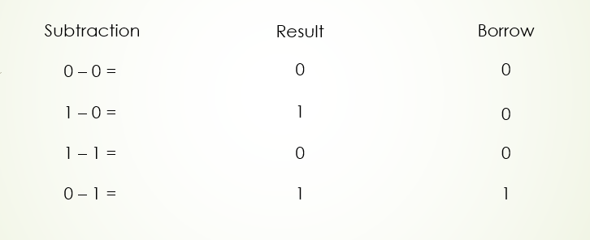
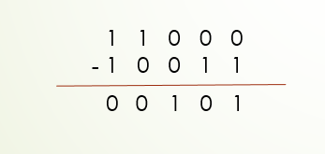
Binary Subtraction-
1
1
1
1 1 0 0 0
1 0 0 1 1
-
1
1
0
0
0
1
0
1
+1
+1
+1
1 + 1 = 1 0
Carry

